Slide 1
Moving Average

Slide 2
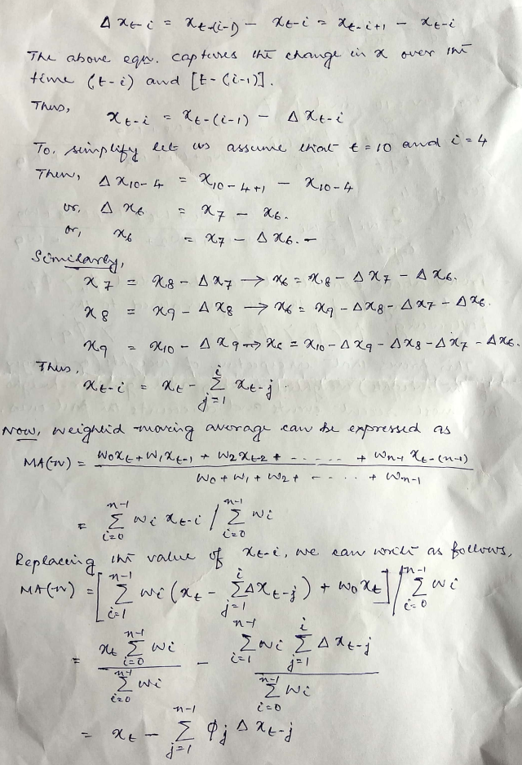
Moving Averages can be construed as –
An extension of white noise series
The second approach could be as AR series with some parameter restriction.
From the adjacent workout , it can be seen the any past value can be expressed as current value and summation of all fluctuation.
Using the same property, it can be shown Moving Average can also be expressed as a combination of current value and all weighted fluctuations since the commencement of the series.

Slide 3
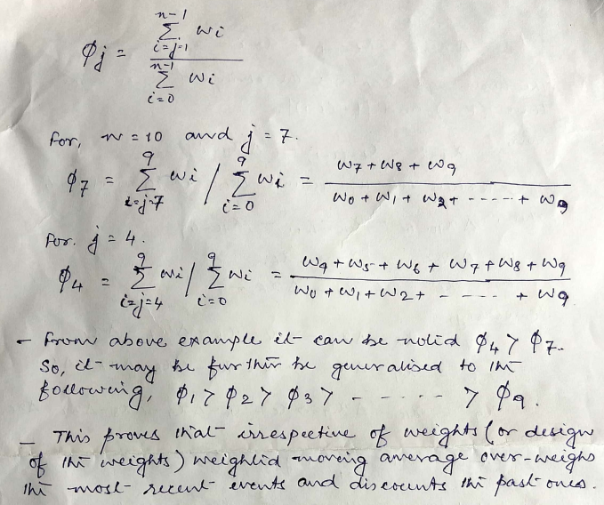
MA…..
From the adjacent workout, it can shown that the weighting scheme of Weighted Moving Average always favours the recent output compared to past.

Slide 4
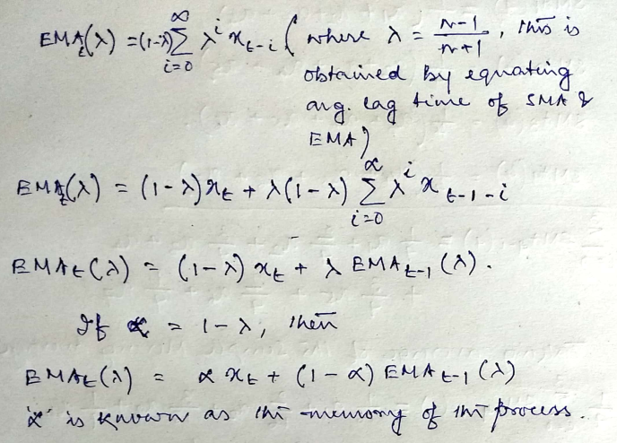
EMA…..
EMA can be expressed as a linear combination of current value and previous shocks , in the same way exponential moving average can also be expressed.
EMA at “t” can be expressed as the weighted moving average of current value at “t” i.e. x(t) and exponential moving average at (t-1). The weights are α and (1- α).
So, the choice of α , determines the higher it is greater is the weight on current value.
The result of EMA and SMA will be very same if λ is set at (n-1)/(n+1) , this has been arrived by equating average lag periods of EMA and SMA.

Slide 5
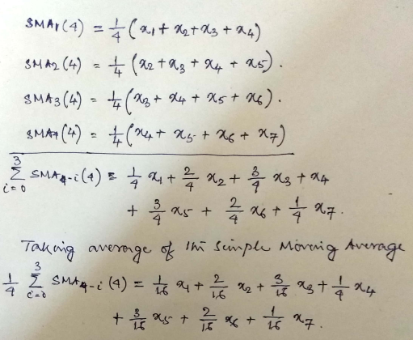
Ma and Smoothness…
From the following workout, we can see that 4 times simple moving average have been estimated with a window size of 4 periods.
In case of SMA the weights are equal for each observations.
As we take average of SMA, one can note that weighing scheme for the observations have been changed.
The most frequent observations has got highest weight. This was not the case for WMA and EMA, where there was bias again the past observation and the weighing scheme favoured the recent events.
Aa a results the window size also increased to 7 periods.

Slide 6
Ma and smoothness
The uses of MA has many dimensions like it helps to capture randomness in movement (i.e. random walk) , similarly MA plays an important role to capture smoothness of an time series.
we have already seen that as the window for estimating increases the lag of various averages increases at the same time smoothness increases.
But to enhance the smoothness of various moving average estimates increasing windows size is not only the option.
One can also take average of averages – as a result the weighing schemes is altered. Triangular Moving average (TMA) is the simple moving average of SMA.

Slide 7
Moving Average
Moving average can be expressed as an extension of AR models in the following manner , where thetas are the weights of past observations –
Where
the same series from (t-1) can be expressed in the following manner –
If the above equation is multiplied by and subtracted from the first equation we arrive at

Slide 8
moving average
The following equation can be interpreted as a function of present and past shocks
The first term is a constant one (may expressed as Co) the remaining are the noise at point “t” and “t-1”,
With the help of a Backshift operator the above equation can be written as
Similarly, MA(2) i.e. moving average order 2 can be written as
And MA(q) can be written as

Slide 9


Properties of MA
Stationarity condition for MA(1) : E(x(t)) = Co and
For MA(q) also same property holds , only the variance becomes
For MA(1) , it can be shown that auto-covariance and for l >0 , under the assumption that Co = 0.
And the auto-correlation can be written as
For a MA(2) model the auto-correlations can be written as

Slide 10
MA order
Like PCAF and Information criteria is used to determine the order of the AR , in case of MA, ACF is used.
This can be done as moving averages can be expressed as an combination of current value of the series and all previous shocks. In the subsequent sections we will see how this can be done.
If auto-correlation of order q is not zero , but auto-correlation higher than q is zero , then the order MA is said to be q.
Visually one can identify the values which crosses or touches the confidence intervals – such values can be significant and the order of MA can be decided.

